Slide 1
Efficient Deformable Tissue Reconstruction via Orthogonal Neural Plane
汇报人：王凯灵
2023年9月

Slide 2
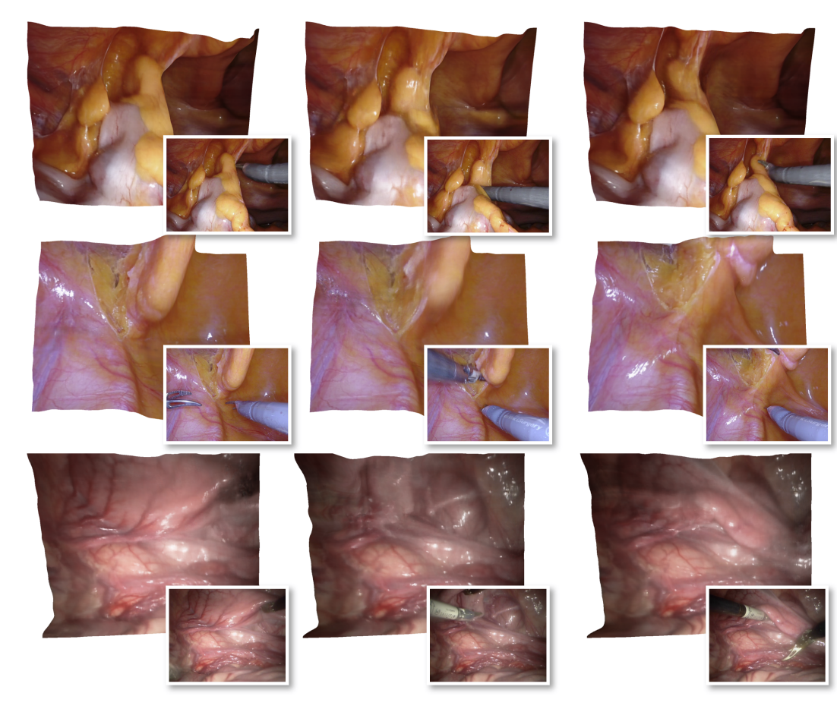
Task
Rapid 3D Model Reconstruction from Endoscopic Images
Importance:
Assisting in diagnosis, detection, and observation of lesions
Assisting and navigating surgical robots intraoperatively
Assisting in simulation and training of surgical robot visual models

Slide 3
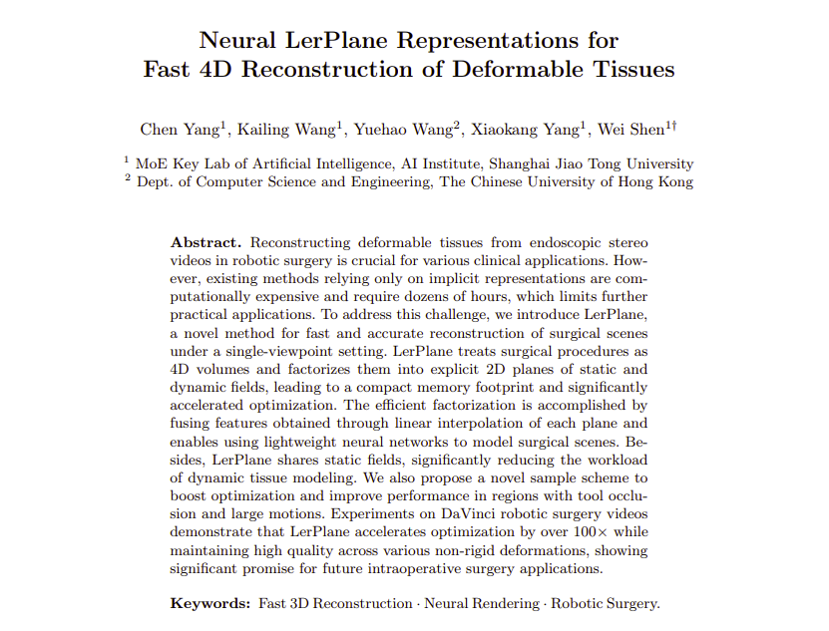
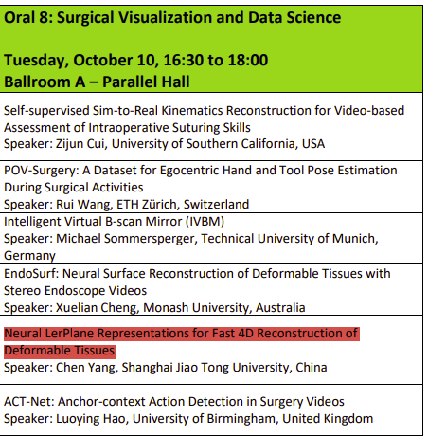
Previous work

Slide 4
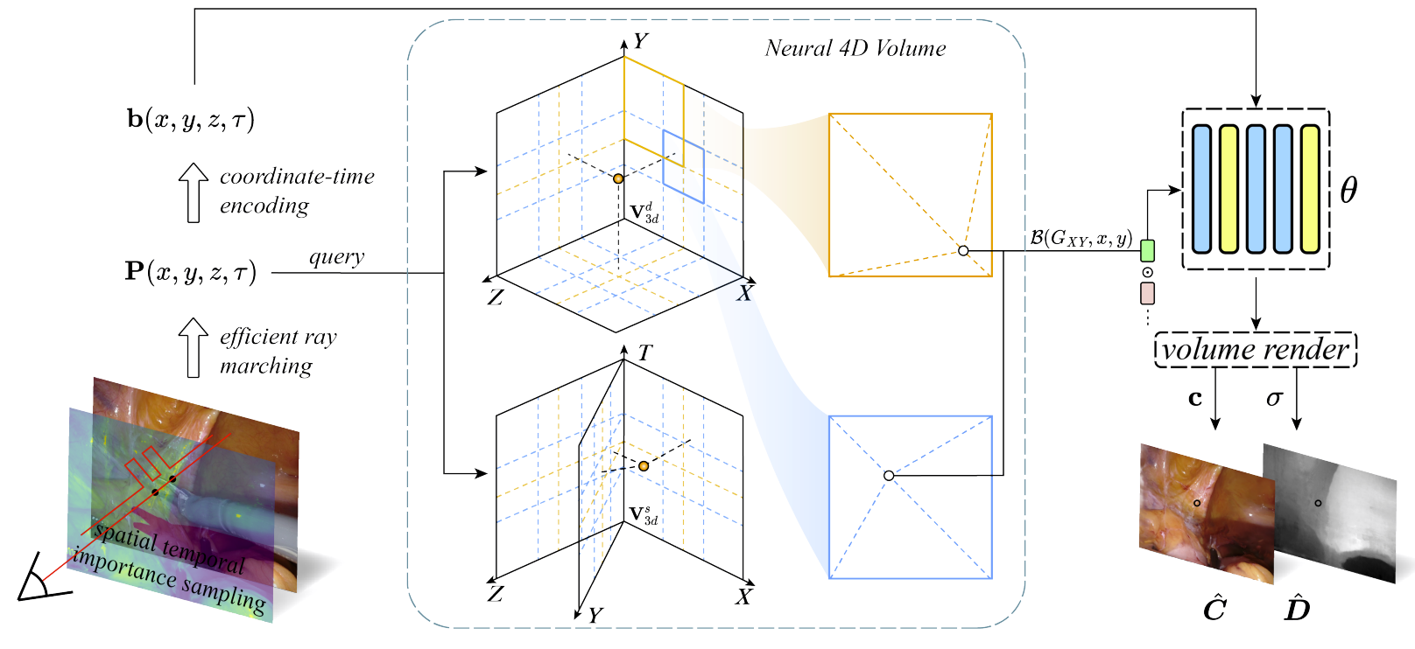
Pipeline: Forplane

Slide 5
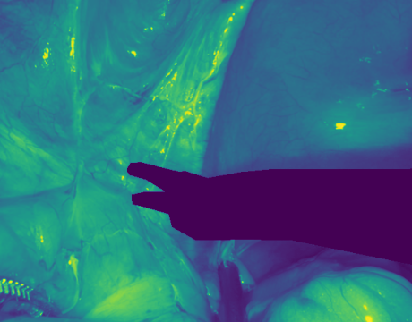
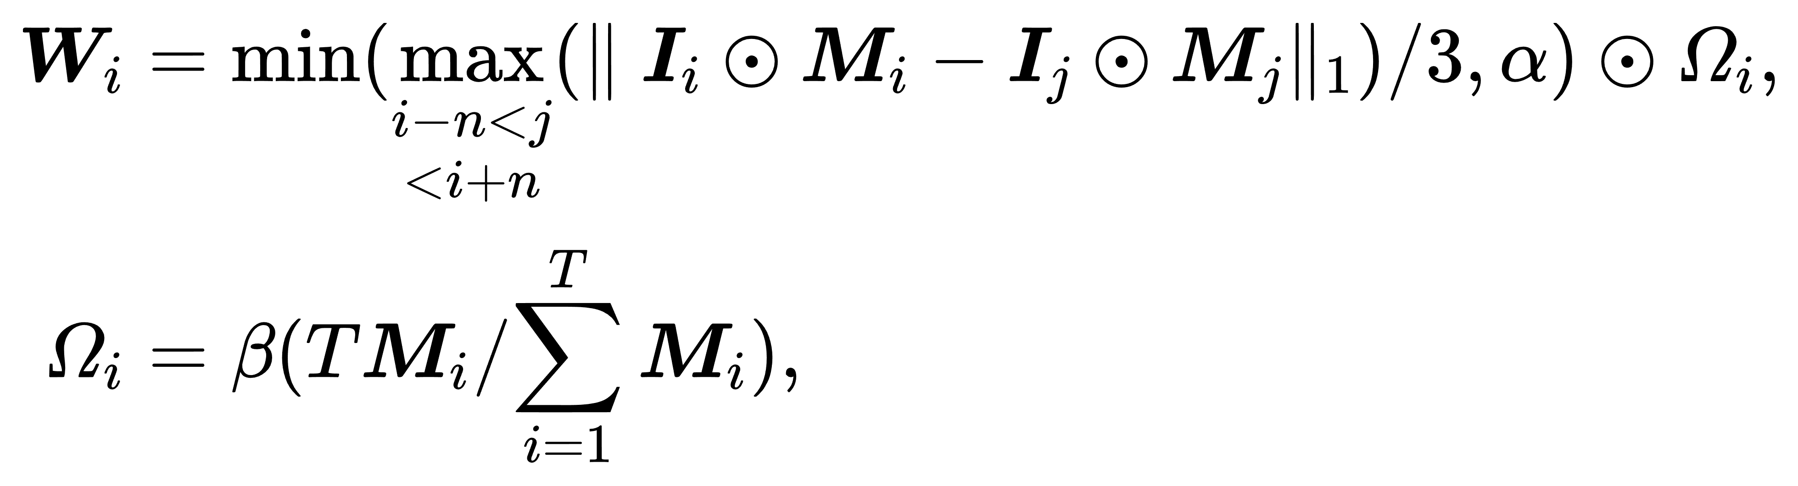
Sampling
Spatiotemporal Importance Sampling
Pixels that:
occluded by tools
exhibit extensive motion ranges

Slide 6
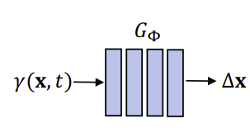
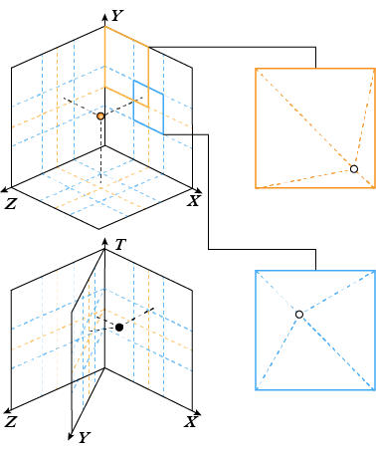
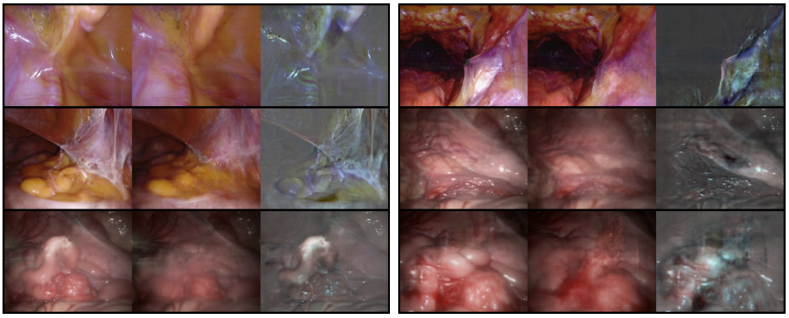
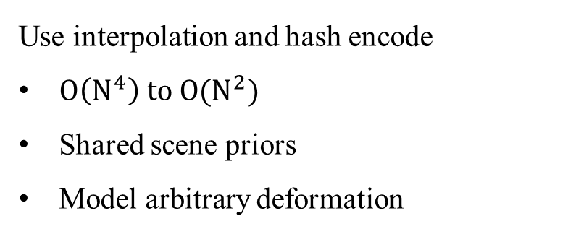
Orthogonal Plane
Use interpolation and hash encode
$O\left(N^{4}\right) to O(N^{2})$
Shared scene priors
Model arbitrary deformation

Slide 7
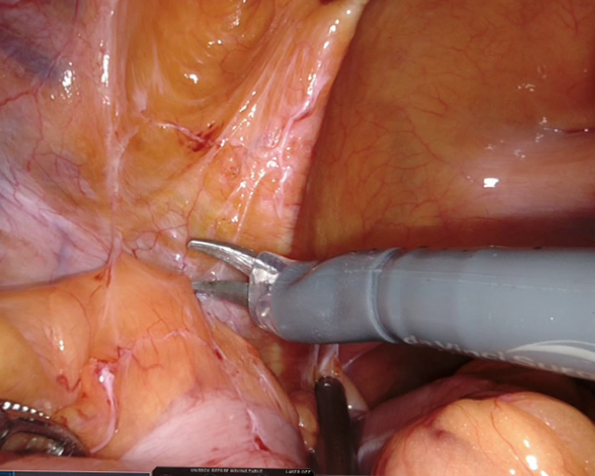
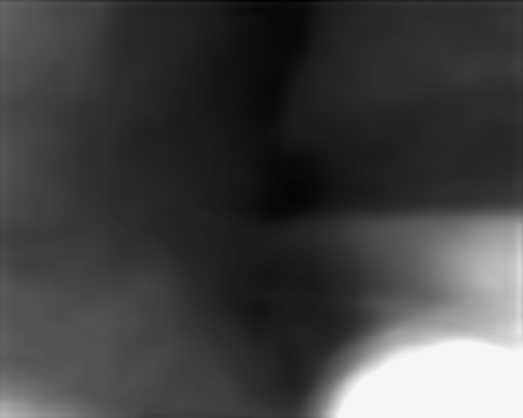
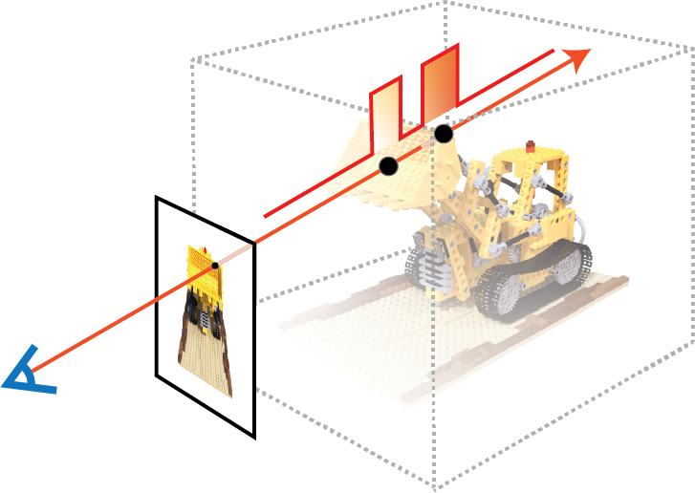

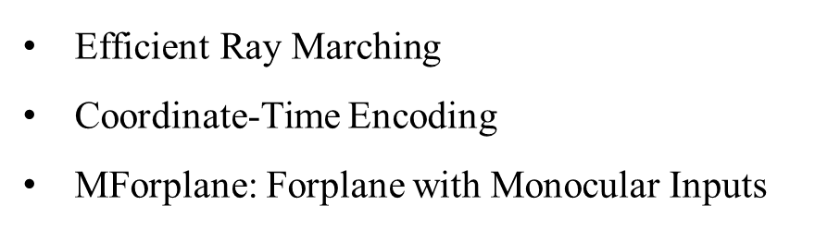
Other Advancements
$\text{Efficient} \text{Ray} \text{Marching}$
Coordinate-Time Encoding
MForplane: Forplane with Monocular Inputs

Slide 8
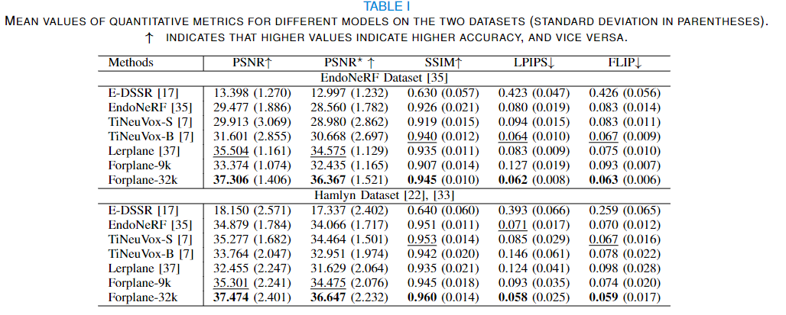
Performance

Slide 9
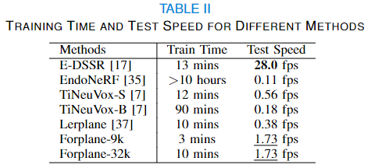
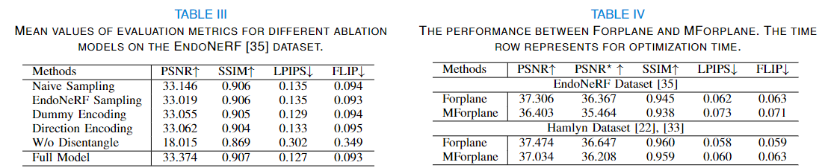
Performance

Slide 10





Slide 11
Future Work Prospects
Further accelerate to 30+ fps to truly enable real-time render
Acquire high-quality dataset
Explore the best plane decomposition
Apply adaptive method
Try sim-to-real

Slide 12

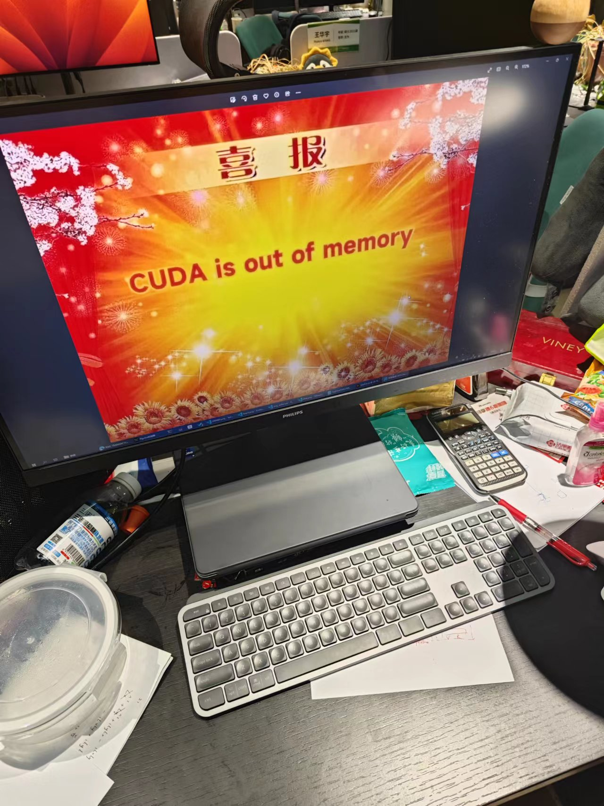
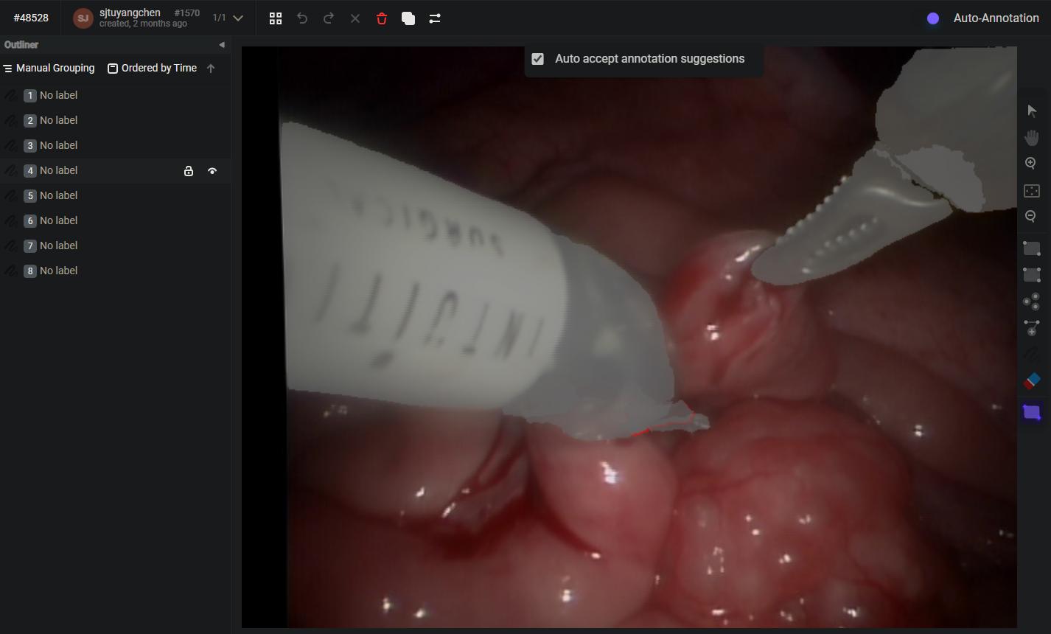
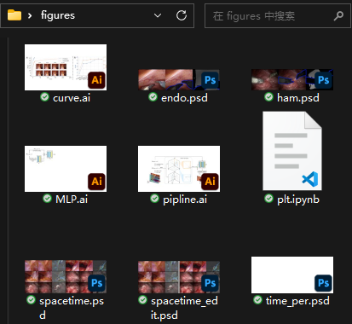
Contribution and Gains
My contribution:
Label tool mask of thousands of bloody images
Implement around half of the code
Config and analyze most of the experiments
All the figures, tables and supplement in the paper, and some of the paras
Work mostly on-site

Slide 13
Thank you!
恳请各位老师批评指正

